Slide 1

Sandro Pereira
Integration Codeless Wizard at DevScope Lda.
BizTalk Server: Lessons from the Road

Slide 2





Who am I?
Integration Codeless Wizard
Microsoft Azure & Visio MVP
sandro.pereira@devscope.net
linkedin.com/in/sandropereira
@sandro_asp
https://blog.sandro-pereira.com/
Public speaker
Book author: “BizTalk Mapping Patterns and Best Practices”
Sandro Pereira
+351 223 751 350
www.devscope.net
Notes:
Interested in all things integration – which of course includes MS Flow

Slide 3




Thanks!
Visual Studio &
Development Technologies
Data Platform
Microsoft Azure
& Visio
Microsoft Azure
DevScope
+351 223 751 350
support@devscope.net
https://pt.linkedin.com/company/devscope
@DevScope
www.devscope.net
Microsoft MVP Award recognizes exceptional community leadership

Slide 4

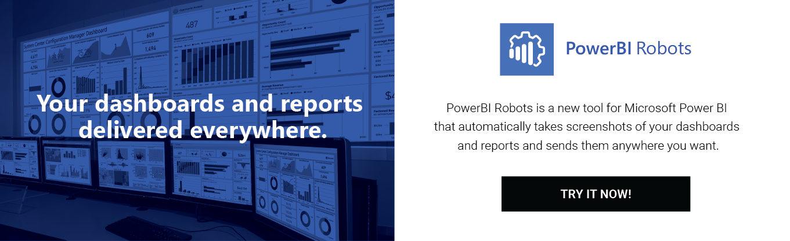
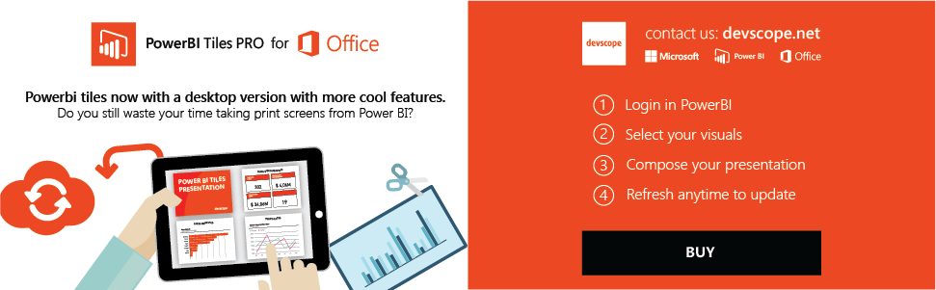
Free licenses courtesy of…
Tweet #Integrate2018
@sandro_asp

Slide 5
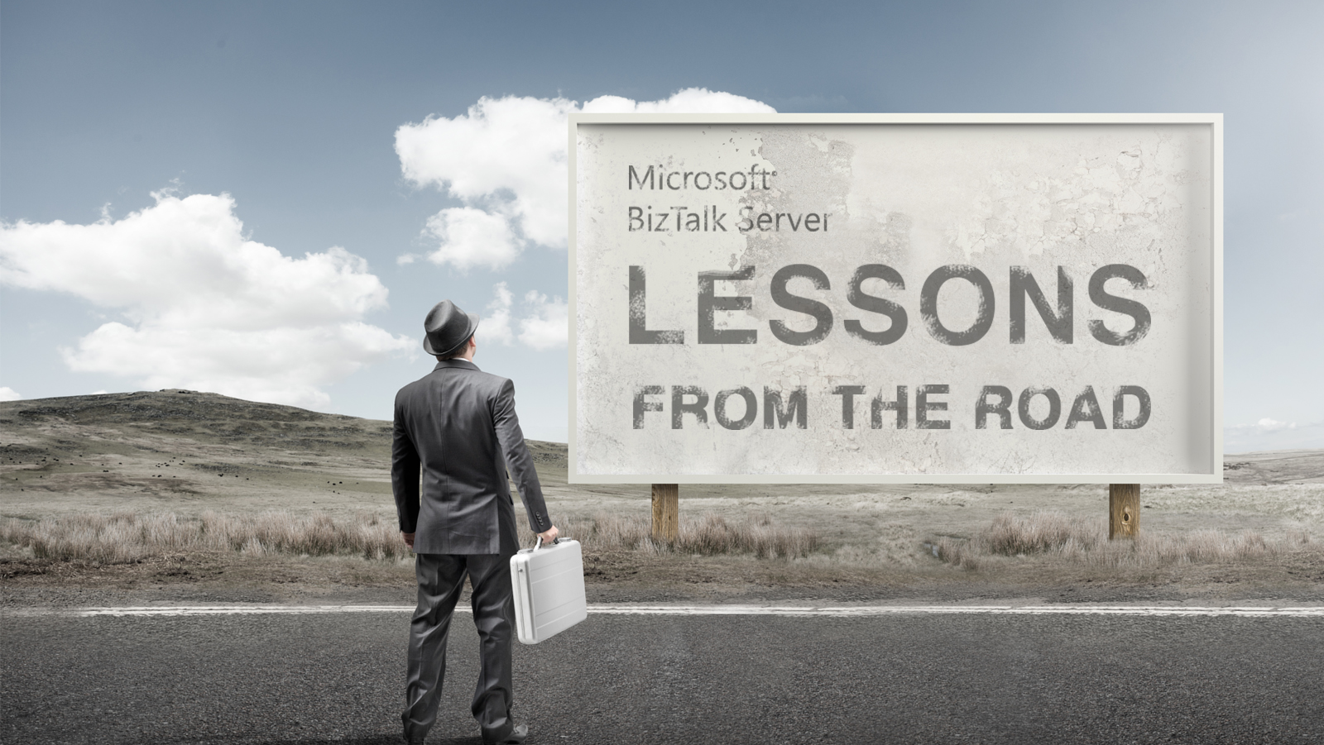

Slide 6

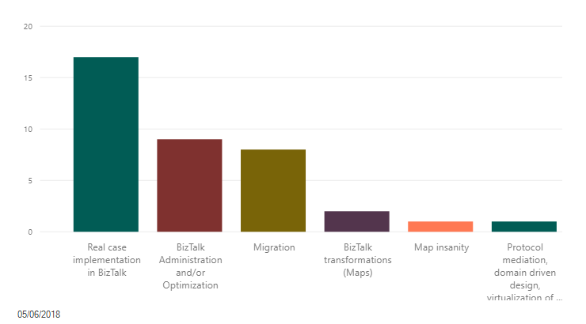
What is the topic you would like to see addressed by me?

Slide 7

1
Lesson

Slide 8

If your “favorite” tool is an hammer…

Slide 9




… All you will see are nails…

Slide 10

Everything that is integration needs to be implemented in BizTalk… or Logic Apps

Slide 11
2
Lesson

Slide 12

When you believe on what you doing… …you just need to keep going!
Notes:
Gartner recognizes Microsoft as a leader in enterprise integration

Slide 13

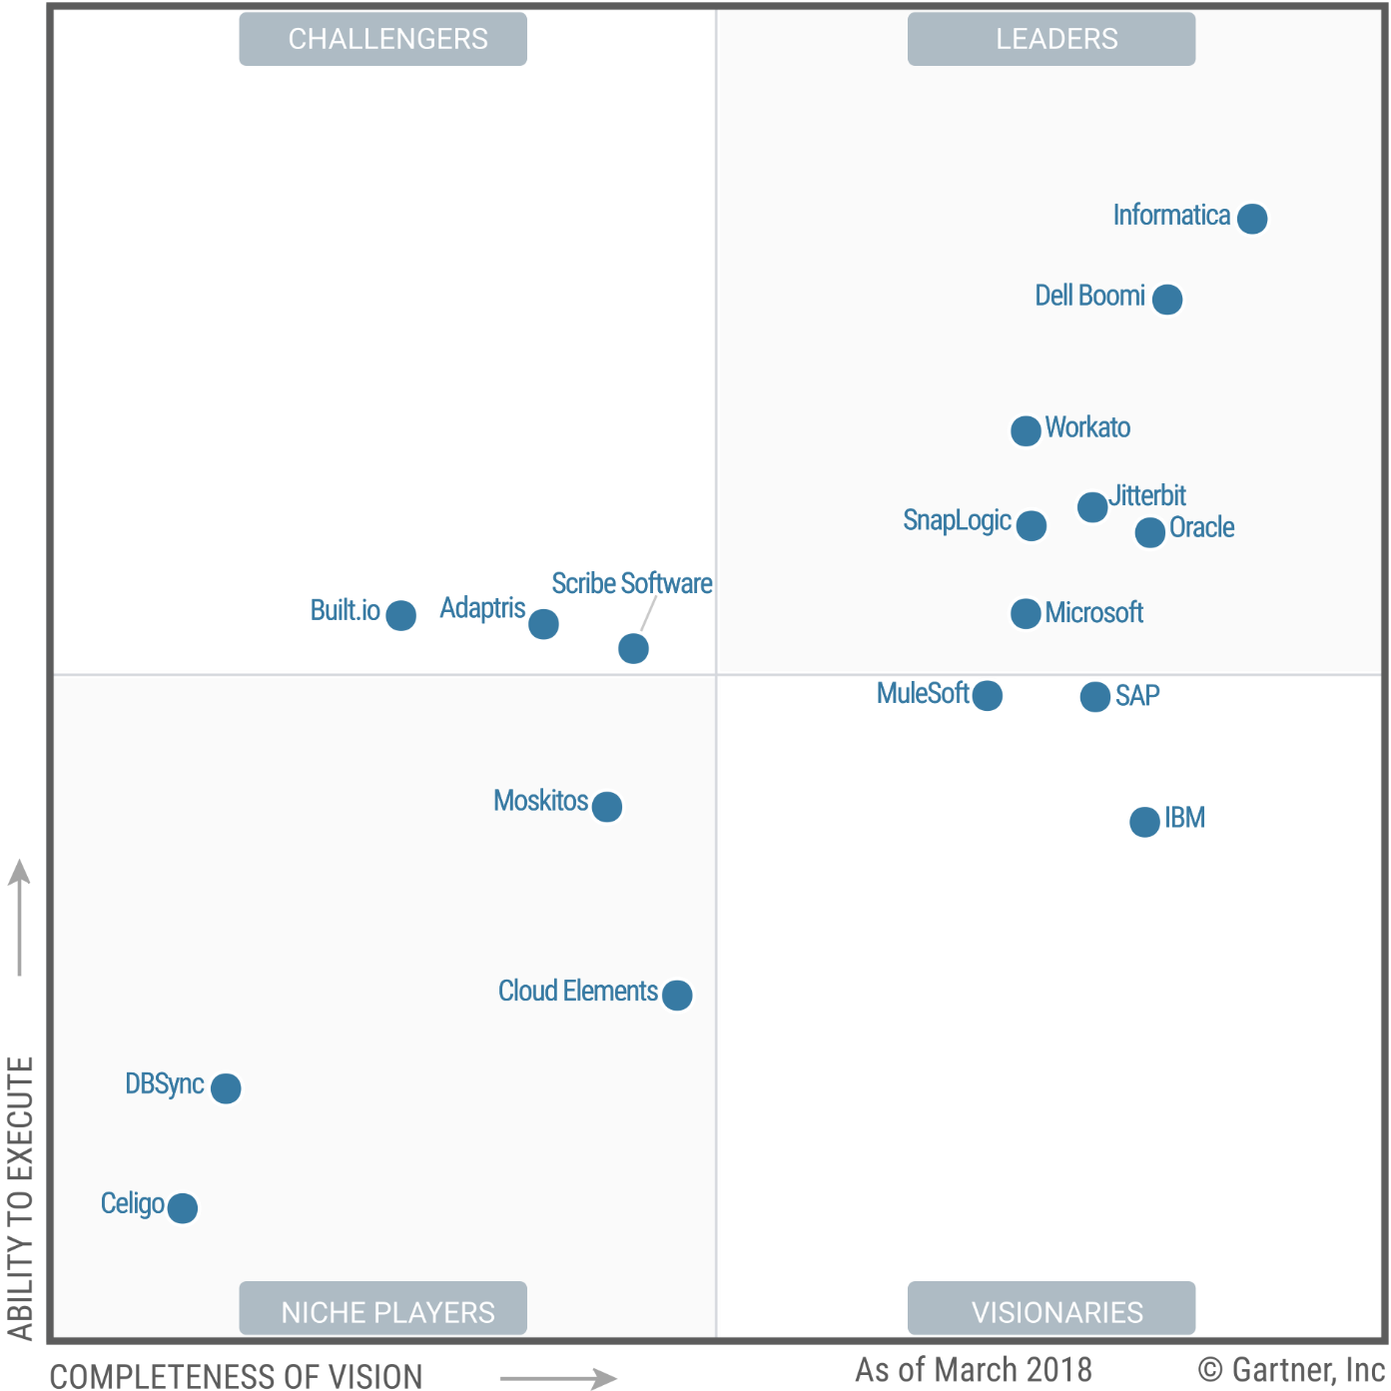
THANK YOU…
MICROSOFT!
Notes:
Gartner recognizes Microsoft as a leader in enterprise integration

Slide 14

Now I need to find another excuse for my sales pitch.…

Slide 15
3
Lesson

Slide 16

communication
consent
access
sensitive data
warnings
rectification
profiling
erase data

Slide 17

In its essence… BizTalk is GDPR compliant
XML EDI or Flat File
XML EDI or Flat File
Receive Port
Orchestration
Send Port
Receive Adapter
Receive Location
Send Adapter
Receive Pipeline
Send Pipeline
Mapping
Mapping
FROM: Contoso (Flat file format)
TO: NWTraders (Flat file format)
TO: Fabrikam (XML format)
MessageBox
FROM: Fabrikam (XML format)
Notes:
The two main services in BizTalk Server 2010, the messaging engine and the orchestration engine
O objetivo do BizTalk é processar mensagens. Toda a comunicação dentro e entre um servidor de BizTalk são baseados na troca de mensagens. Por esse motivo, o mecanismo de mensagens é essencial para todas as operações do BizTalk.
The BizTalk messaging engine performs the following tasks:
Receives inbound messages
Parses inbound documents to identify their specific formats
Extracts key identifiers and identifies applicable routing rules
Delivers documents to their respective destinations including ports or orchestrations
Tracks documents
Message database
The MessageBox database is a Microsoft SQL Server™ database that is used by BizTalk to store and route messages to orchestrations and send ports. When a message arrives in the MessageBox database, the metadata associated with the message is matched and evaluated to determine the services that subscribe to messages of this type.
Publish-Subscribe Model
BizTalk Server implements a publish-subscribe model for the routing of messages. In the publish-subscribe model, message providers (publishers) submit messages to a central store (the MessageBox), where subscribers (send ports and orchestrations) can subscribe to specific messages. After a message of interest is received by the MessageBox, it is sent to all subscribers

Slide 18

But BizTalk Applications…
they are a different story!

Slide 19


Stop configure password in clear text in config files
Reduce the number of people that can remotely access to BizTalk/SQL Server machines
Stop exposing SOAP / WCF / HTTP services in an anonymous way, even if they are internally only!
Reduce the Message body tracking to a minimum
Avoid using FILE / FTP and start using secure channels
WCF-SQL Adapter support for Always Encrypted
STOP LOGGING EVERYTHING, like full body messages, in Event Viewer or LOG FILES
https://www.disguises.com.au/

Slide 20
4
Lesson

Slide 21
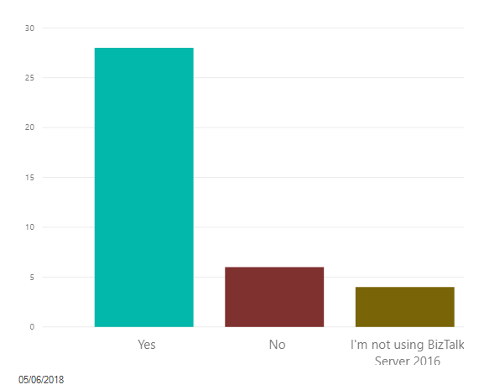
Do you install Feature Packs in BizTalk Server 2016?

Slide 22

BizTalk Feature Packs provides only non-breaking features

Slide 23

…but may break your Applications…

Slide 24
Real sample of Siebel JSON request…
JSON syntax is derived from JavaScript object notation syntax:
Data is in name/value pairs
Data is separated by commas
Curly braces hold objects
Square brackets hold arrays
Some of these names may have empty spaces!
{
"body": {
"SiebelMessage": {
"IntObjectName": "EAI Account Light",
"ListOfClient EAI Account Light": {
"Account": {
"Nome": "Why the hell you want to put empty space in our elements/names?"
}
}
}
}
}

Slide 25
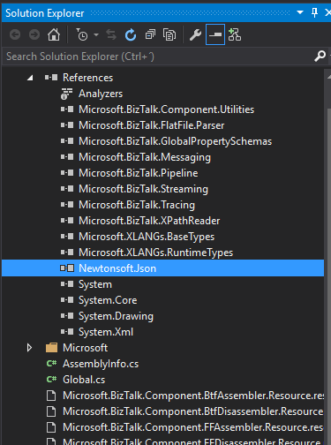
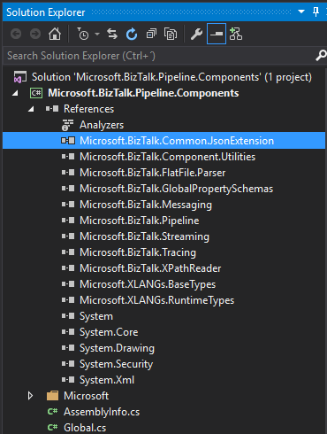
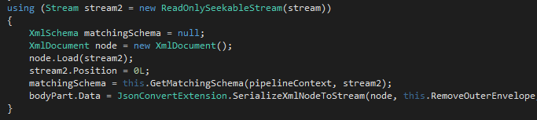
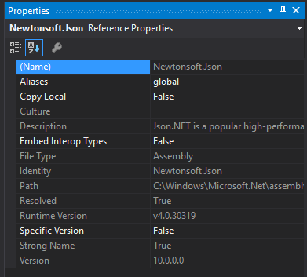
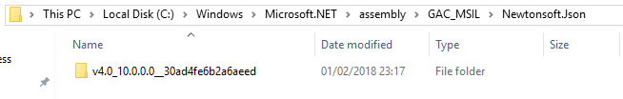
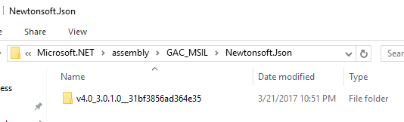
Default installation…
Now with Feature Pack 2

Slide 26
5
Lesson

Slide 27
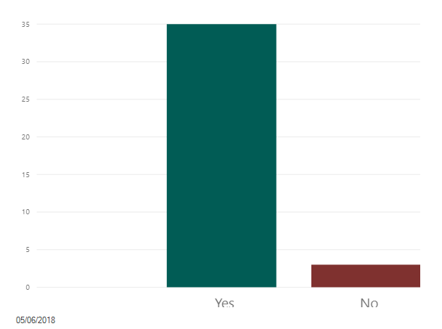
Do you normally install Cumulative Updates in your environment?

Slide 28

Install
Cumulative Updates…?
… is this
good or bad?

Slide 29

Cumulative Update 1 for BizTalk Server 2016
Cumulative Update 6 for BizTalk Server 2013 R2.
Cumulative Update 5 (CU5) for BizTalk Server 2013
Orphaned BizTalk DTA service instances are not removed
Notes:
Cumulative Update 1 for BizTalk Server 2016
Cumulative Update 6 for BizTalk Server 2013 R2.
Cumulative Update 5 (CU5) for BizTalk Server 2013

Slide 30
6
Lesson

Slide 31

When you think in B2B… you think EDI…
…Electronic Invoice, Order and so on

Slide 32

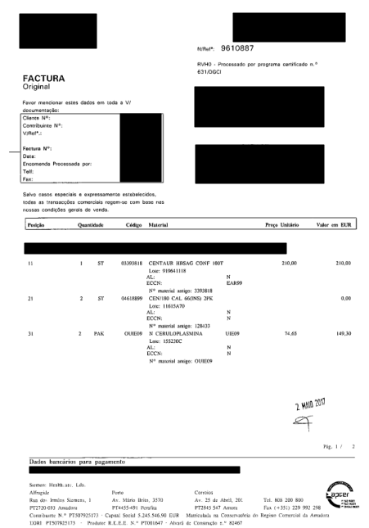
demo
Notes:
papper

Slide 33
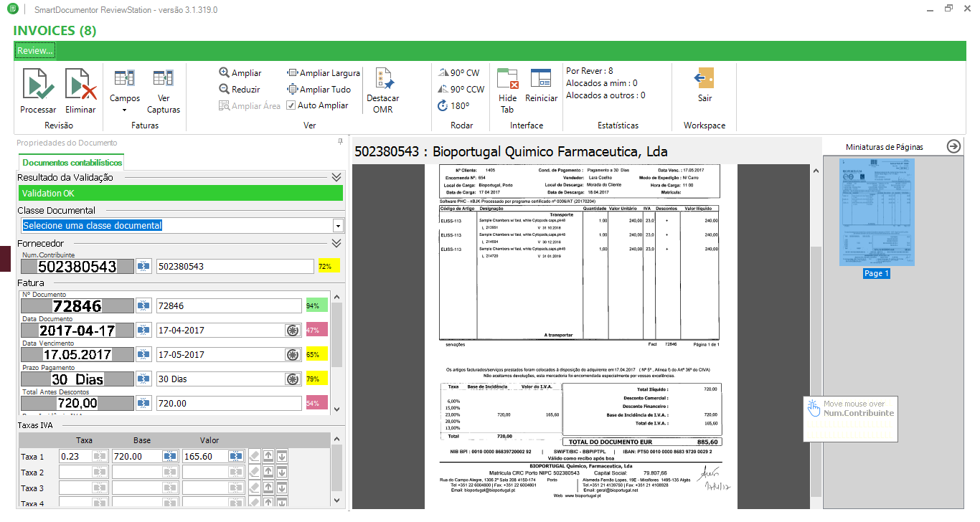

Slide 34
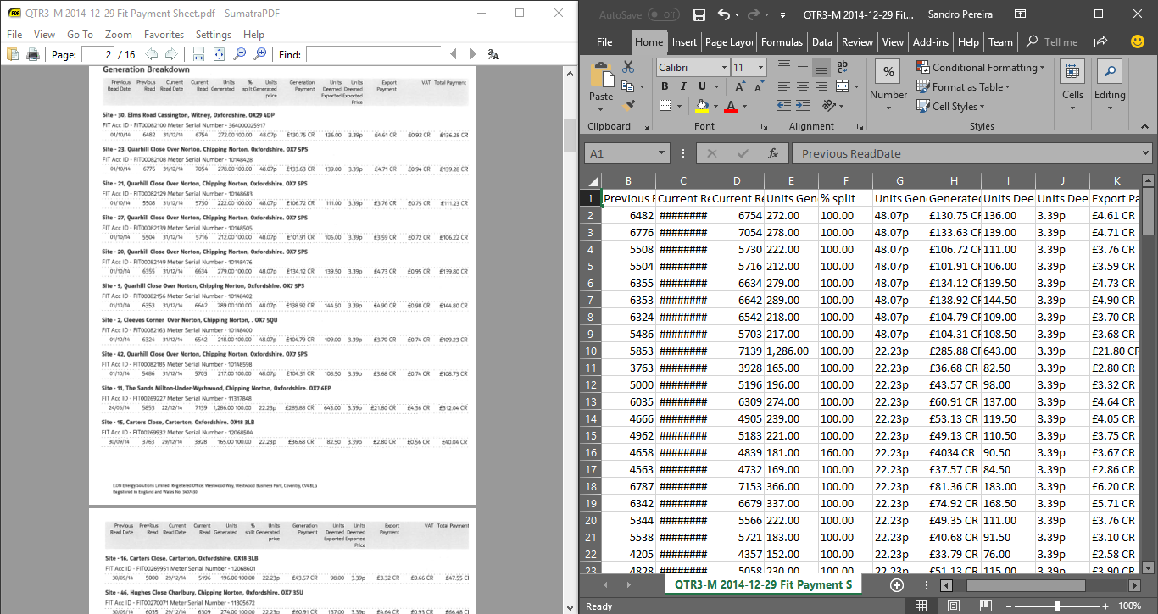

Slide 35
7
Lesson

Slide 36

Aggregator Orchestration!?
Singleton Orchestration?!
Sequence Convoy?!

Slide 37

Reentry process’s design Asynchronous process’s design
demo

Slide 38
8
Lesson

Slide 39

BizTalk REST support…
…need’s support

Slide 40
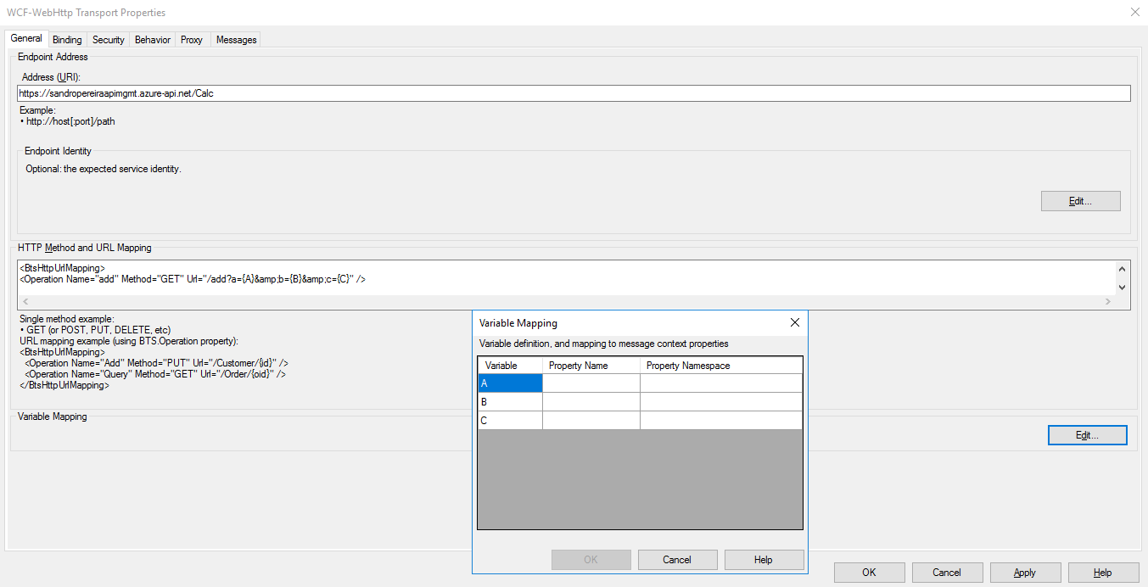
Out-of-the-box it is impossible to easily handle optional parameters…

Slide 41
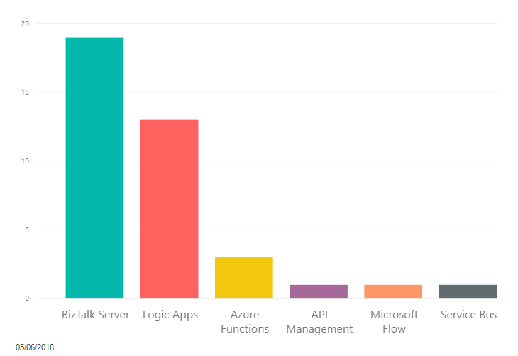
What is your favorite "piece" of Microsoft Enterprise Integration?

Slide 42

I

Slide 43




THANKS!
Sandro Pereira
Integration Codeless Wizard | Microsoft Azure & Visio MVP
sandro.pereira@devscope.net
linkedin.com/in/sandropereira
@sandro_asp
https://blog.sandro-pereira.com/
+351 223 751 350
www.devscope.net

